Slide 1
PHYS 1050 Tutorial 1
Yutong Zhao
Jan 24th 2019

Slide 2
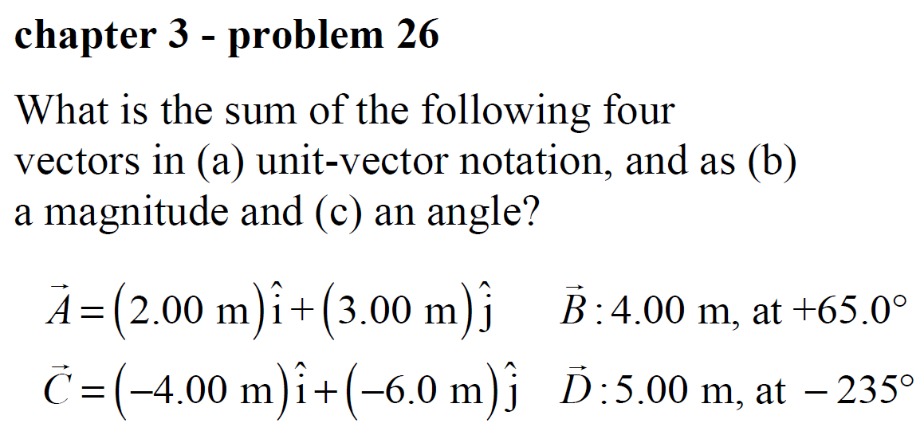

Slide 3
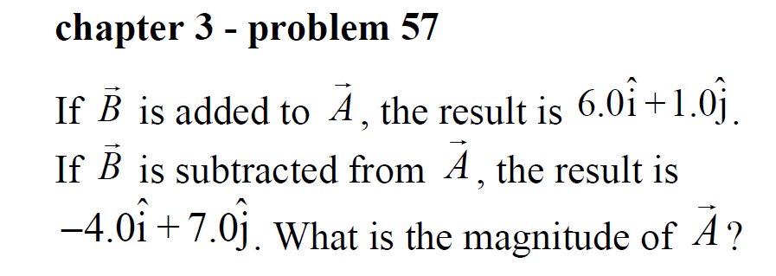
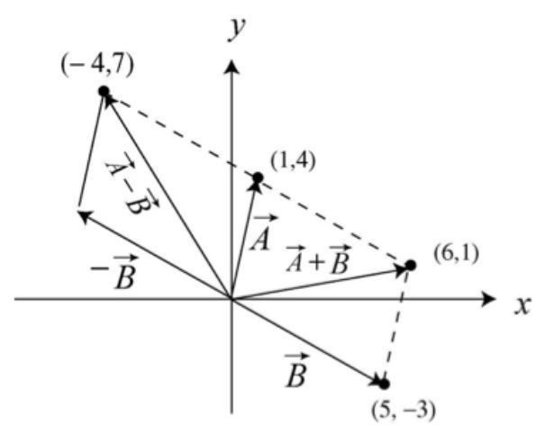

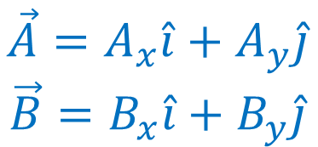


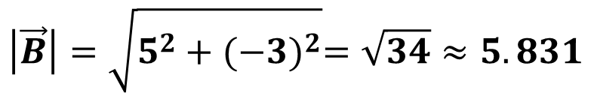

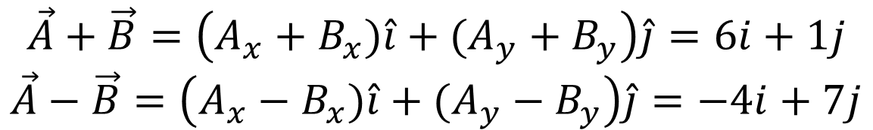

$$\vec{A}=A_{x}\hat{i}+A_{y}\hat{j}$$
$$\vec{B}=B_{x}\hat{i}+B_{y}\hat{j}$$
$$\vec{A}+\vec{B}=\left(A_{x}+B_{x})\hat{i}+(A_{y}+B_{y}\right)\hat{j}=6i+1j$$
$$\vec{A}−\vec{B}=\left(A_{x}−B_{x})\hat{i}+(A_{y}−B_{y}\right)\hat{j}=−4i+7j$$
$A_{x}+B_{x}=6$
$A_{x}−B_{x}=−4$
$A_{y}+B_{y}=1$
$A_{y}−B_{y}=7$
$$\left|\vec{A}\right|=\sqrt{1^{2}+4^{2}}=\sqrt{17}≈4.123$$
$A_{x}=1$
$B_{x}=5$
$A_{y}=4$
$B_{y}=−3$
$$\left|\vec{B}\right|=\sqrt{5^{2}+{(−3)}^{2}}=\sqrt{34}≈5.831$$

Slide 4
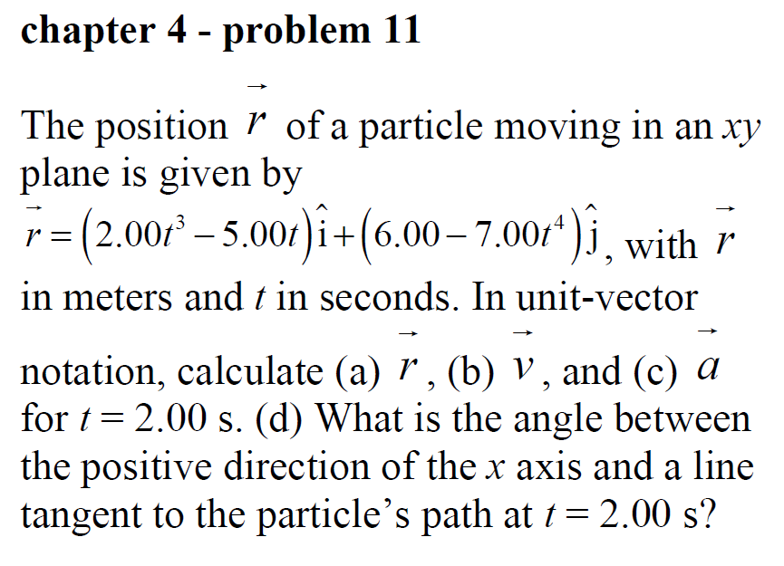
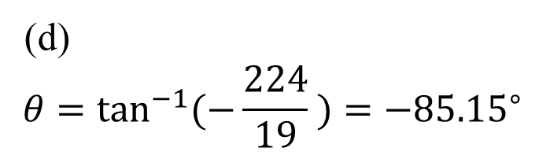
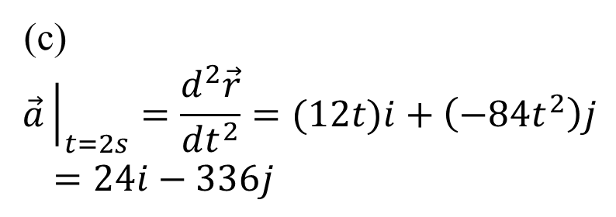
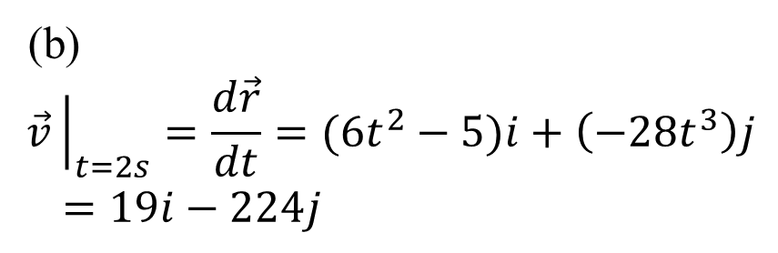
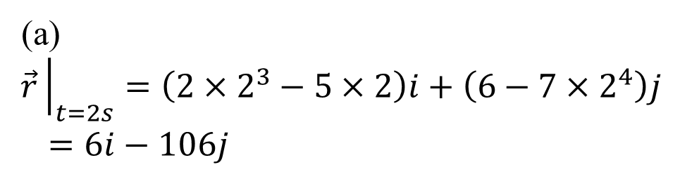
(a)
$$\vec{r}{\left.​\right|}_{t=2s}=\left(2×2^{3}−5×2\right)i+\left(6−7×2^{4}\right)j$$
$=6i−106j$
(b)
$$\vec{v}{\left.​\right|}_{t=2s}=\frac{d\vec{r}}{dt}=(6t^{2}−5)i+\left(−28t^{3}\right)j$$
$=19i−224j$
(c)
$$\vec{a}{\left.​\right|}_{t=2s}=\frac{d^{2}\vec{r}}{dt^{2}}=(12t)i+\left(−84t^{2}\right)j$$
$=24i−336j$
(d)
$$θ=\tan^{−1}{(−\frac{224}{19} )}=−{85.15}^{∘}$$

Slide 5
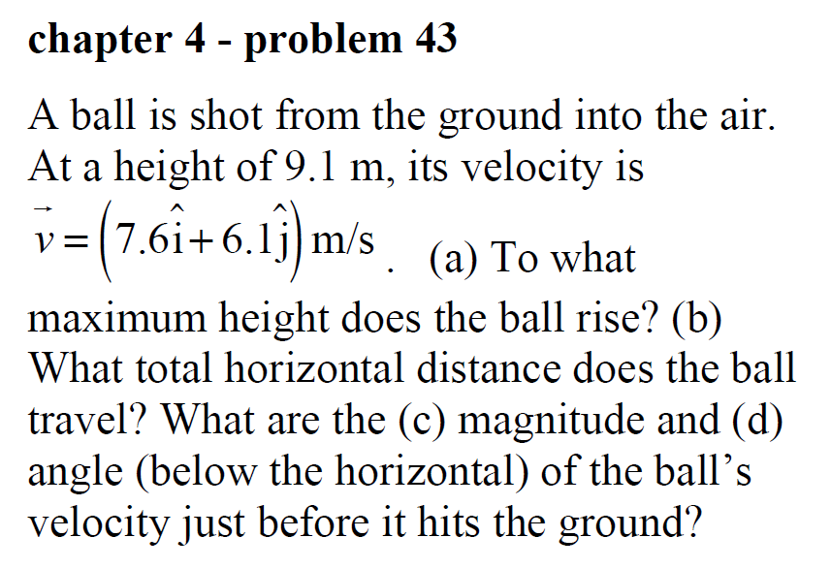

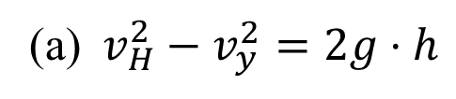

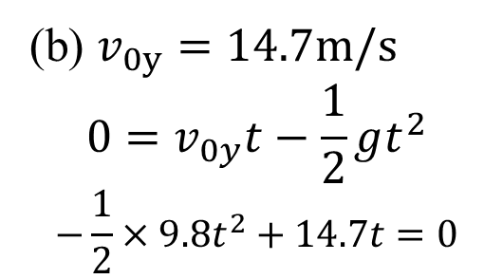
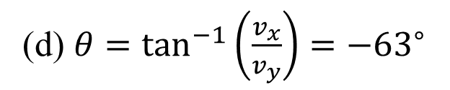

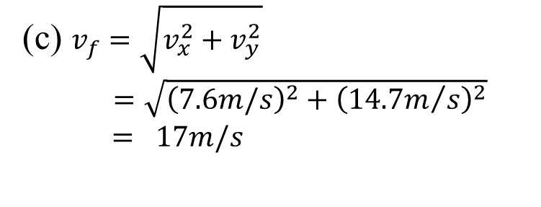
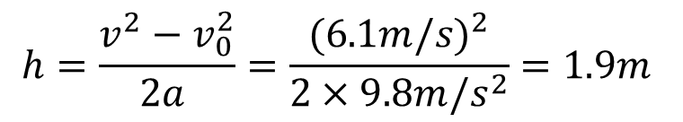
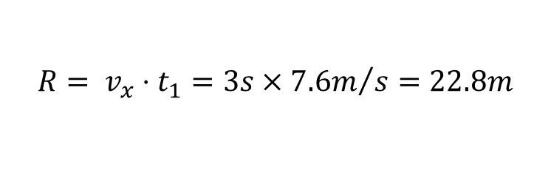
(a)$v_{H}^{2}−v_{y}^{2}=2g⋅h$
$$h=\frac{v^{2}−v_{0}^{2}}{2a }=\frac{{(6.1m/s)}^{2}}{2×9.8m/s^{2}}=1.9m$$
$$H=h+Δh=11.0 m$$
(b) $v_{0y}=14.7m/s$
$$0=v_{0y}t−\frac{1}{2}gt^{2}$$
$$−\frac{1}{2}×9.8t^{2}+14.7t=0$$
$$t_{1}=3s$$
$$R= {v_{x}⋅t}_{1}=3s×{7.6m}/s=22.8m$$
(c) $v_{f}=\sqrt{v_{x}^{2}+v_{y}^{2}}$
$=\sqrt{{\left(7.6m/s\right)}^{2}+{\left({14.7m}/s\right)}^{2}}$
$= 17m/s$
$$h=9.1m$$
(a)
(d) $θ=\tan^{−1}\left(\frac{v_{x}}{v_{y}}\right)=−{63}^{∘}$
(b),(c),(d)

Slide 6
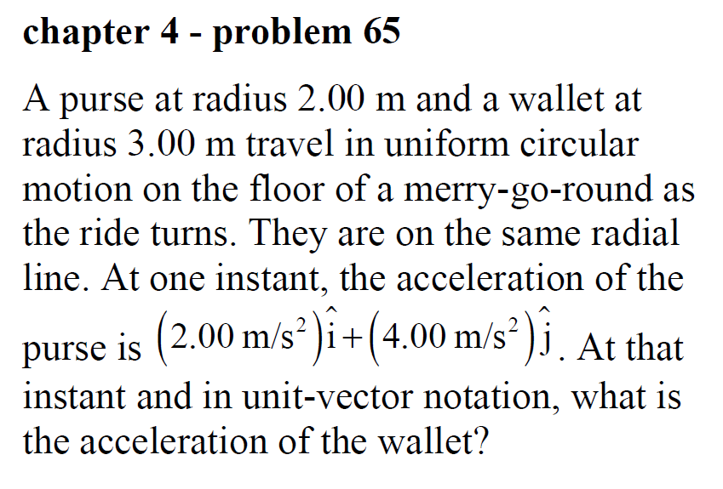

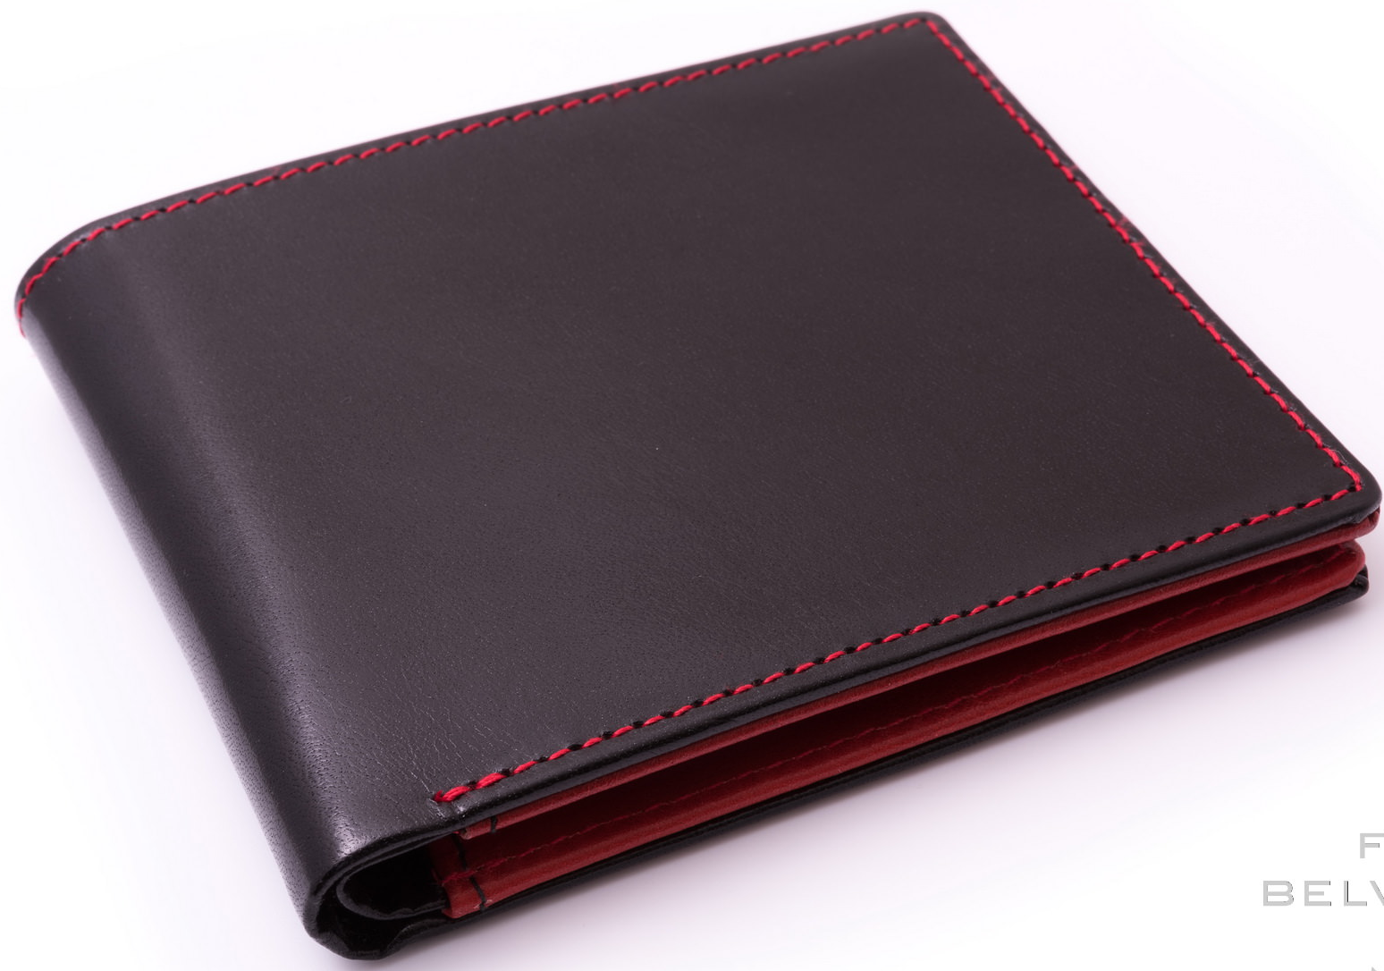

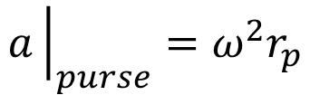


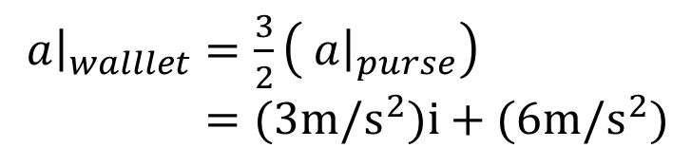
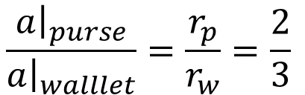
$$a{\left.​\right|}_{purse}=ω^{2}r_{p}$$
$$a{\left.​\right|}_{walllet}=ω^{2}r_{w}$$
$$\frac{a{\left.​\right|}_{purse}}{a{\left.​\right|}_{walllet}}=\frac{r_{p}}{r_{w}}=\frac{2}{3}$$
$$3m$$
$a{\left.​\right|}_{walllet}=\frac{3}{2}\left( a{\left.​\right|}_{purse}\right)$
$=(3m/s^{2})i+(6m/s^{2})$
$$2m$$

Slide 7
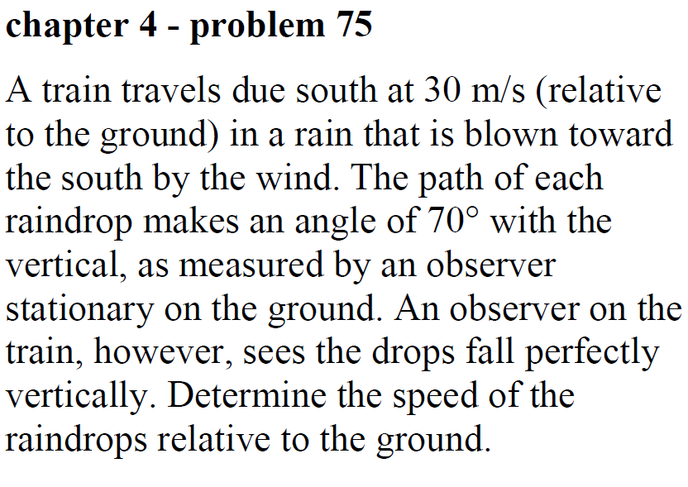
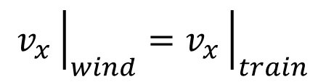





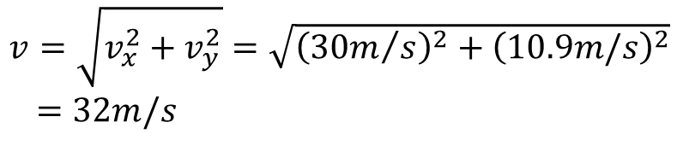
$$v_{x}{\left.​\right|}_{wind}=v_{x}{\left.​\right|}_{train}$$
$v_{y}=\frac{v_{x}}{\tan^{−1}{θ}}=\frac{{30m}/s}{\tan^{−1}{{70}^{∘}}}=10.9m/s$
$v=\sqrt{v_{x}^{2}+v_{y}^{2}}=\sqrt{{\left({30m}/s\right)}^{2}+{\left(10.9m/s\right)}^{2}}$
$=32m/s$
$${70}^{∘}$$
$$v_{y}$$
$$30m/s$$
$$v_{x}$$
South

